Slide 2


Slide 3
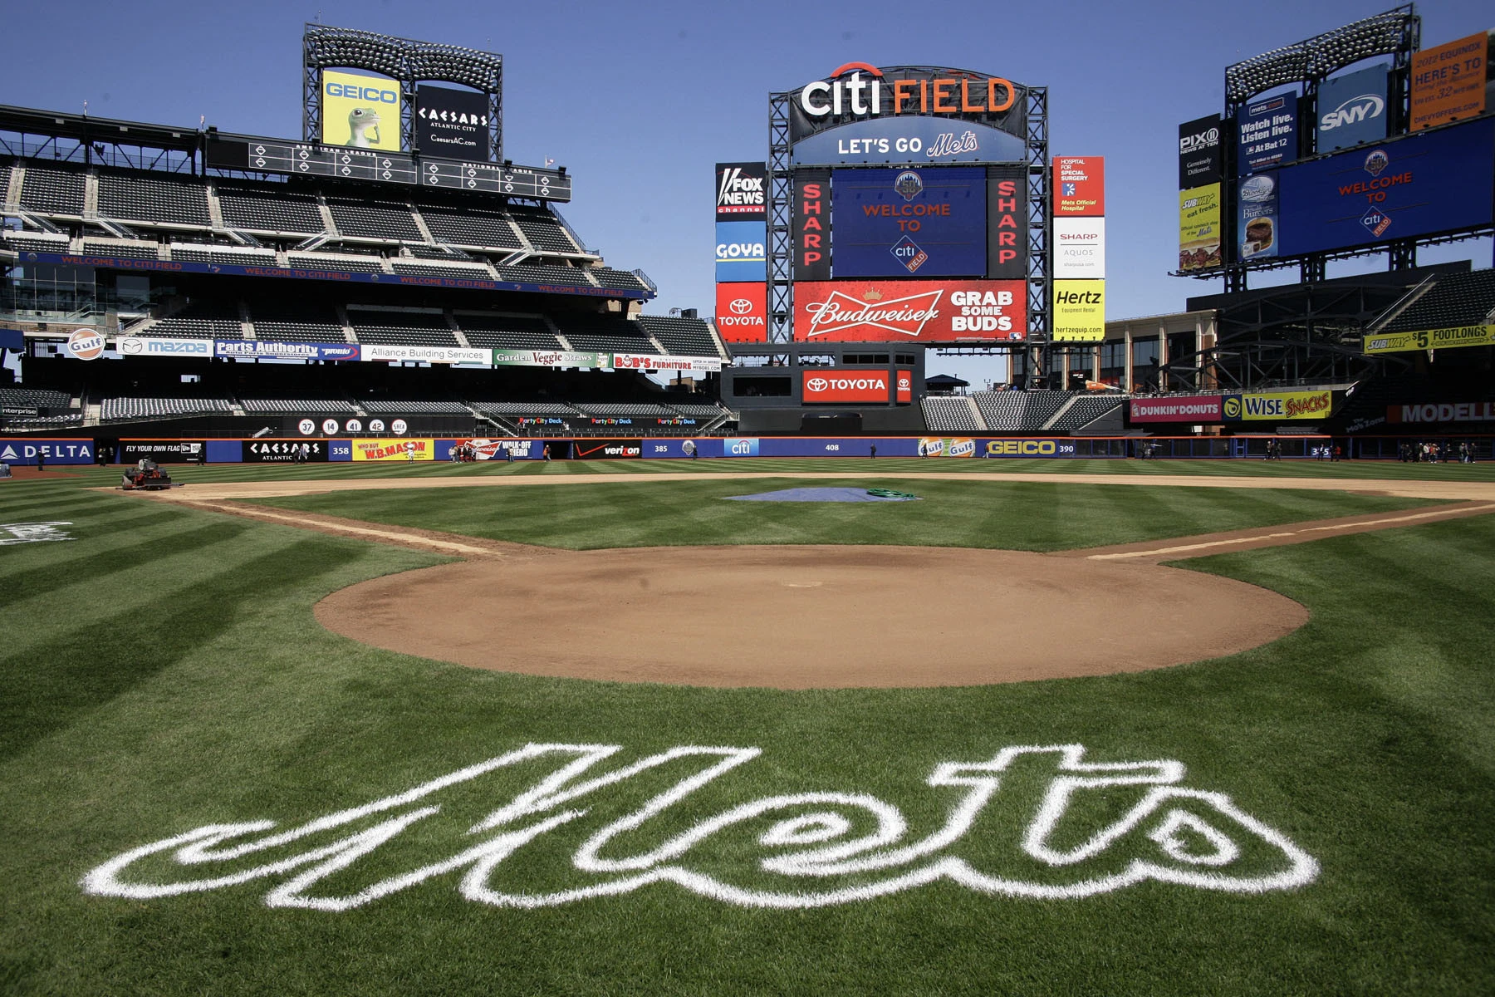
How accurately can we predict
Major League Baseball
game outcomes?
Jacqueline Kuo
October 30, 2019

Slide 4
How accurately can we predict
Major League Baseball
game outcomes?
(aka can we predict my dad’s mood?)

Slide 5


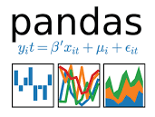


The Data.

Slide 6
The Data.
Data Scope
Game Data
2015-2019
Regular Season
12,150 games
Home Team
Away Team
Day of the week
Player Stats per Game
Pitching
Batting
Fielding
ERA
WHIP
K9
Wins
Losses
OBP
RBI
Batting average
Runs
Slugging
Errors
Assists
Notes:
162 games played per team. 30 teams. 2430 games per season

Slide 7
The Data.
Data Scope
Game Data
2015-2019
Regular Season
12,150 games
Home Team
Away Team
Day of the week
Player Stats per Game
Pitching
Batting
Fielding
ERA
WHIP
K9
Wins
Losses
OBP
RBI
Batting average
Runs
Slugging
Errors
Assists
Notes:
162 games played per team. 30 teams. 2430 games per season

Slide 8
Feature Engineering.
Team Statistics Aggregated from Player Statistics in past games
Raw Player Statistics per game
from SportsRadar API
Player Aggregation
Team & Pitcher Aggregation
Last game stats
Last game stats
Pitching
Batting
Fielding
ERA
WHIP
K9
Wins
Losses
OBP
RBI
Batting average
Runs
Slugging
Errors
Assists
7-game
Average
7-game
Average
30-game
Average
30-game
Average

Slide 9

The Model.
Data
Model
Model
Prediction
Will the Home Team
Game Data
Win
Team & Pitcher
Aggregated
Statistics
Lose
141 Features
Notes:
162 games played per team. 30 teams. 2430 games per season

Slide 10
The Model.
Model Accuracy Scores Compared to Baseline Model
58%
XGBoost
56%
Random Forest
56%
CatBoost
55%
LightGBM
52% Baseline Model
Always predict Home Team Wins
52.7%
Logistic Regression
50%
KNN
Notes:
162 games played per team. 30 teams. 2430 games per season

Slide 11
Model Results: Mets 2019
59%
Accuracy in predicting Mets wins in 2019
Accuracy in predicting my dad’s mood during the baseball season
Notes:
162 games played per team. 30 teams. 2430 games per season

Slide 12
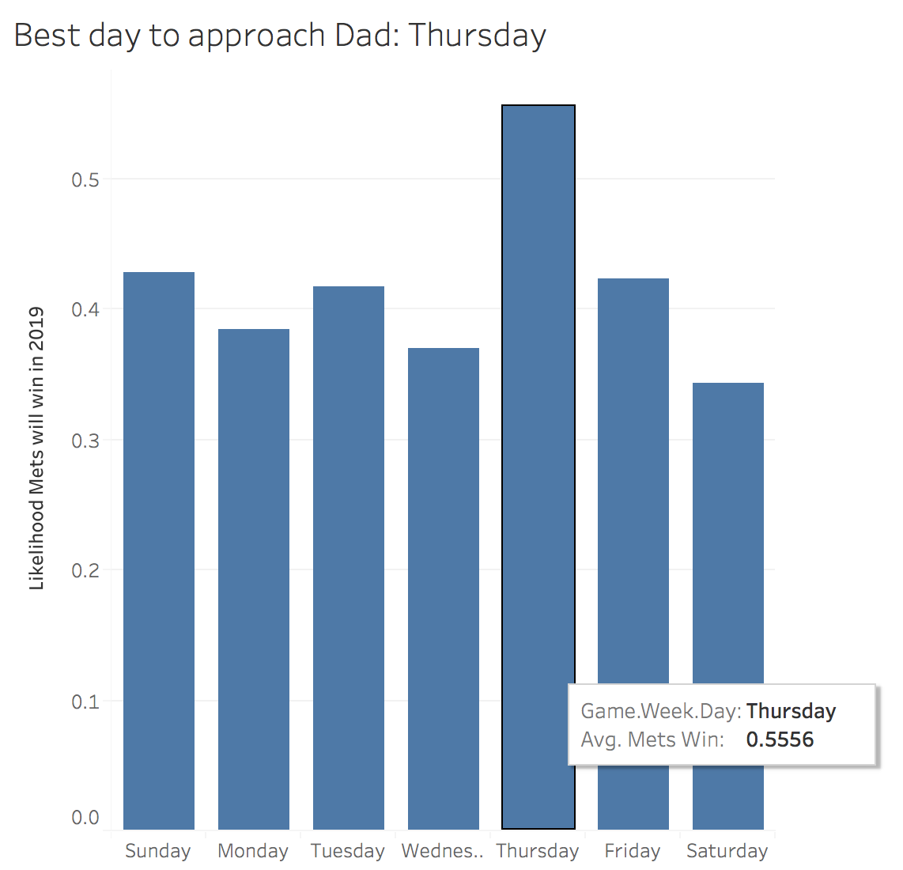
Model Results: Mets 2019
Notes:
162 games played per team. 30 teams. 2430 games per season

Slide 13
Model Results: MLB 2019
56.3%
Accuracy in predicting MLB wins in 2019
Notes:
162 games played per team. 30 teams. 2430 games per season

Slide 14
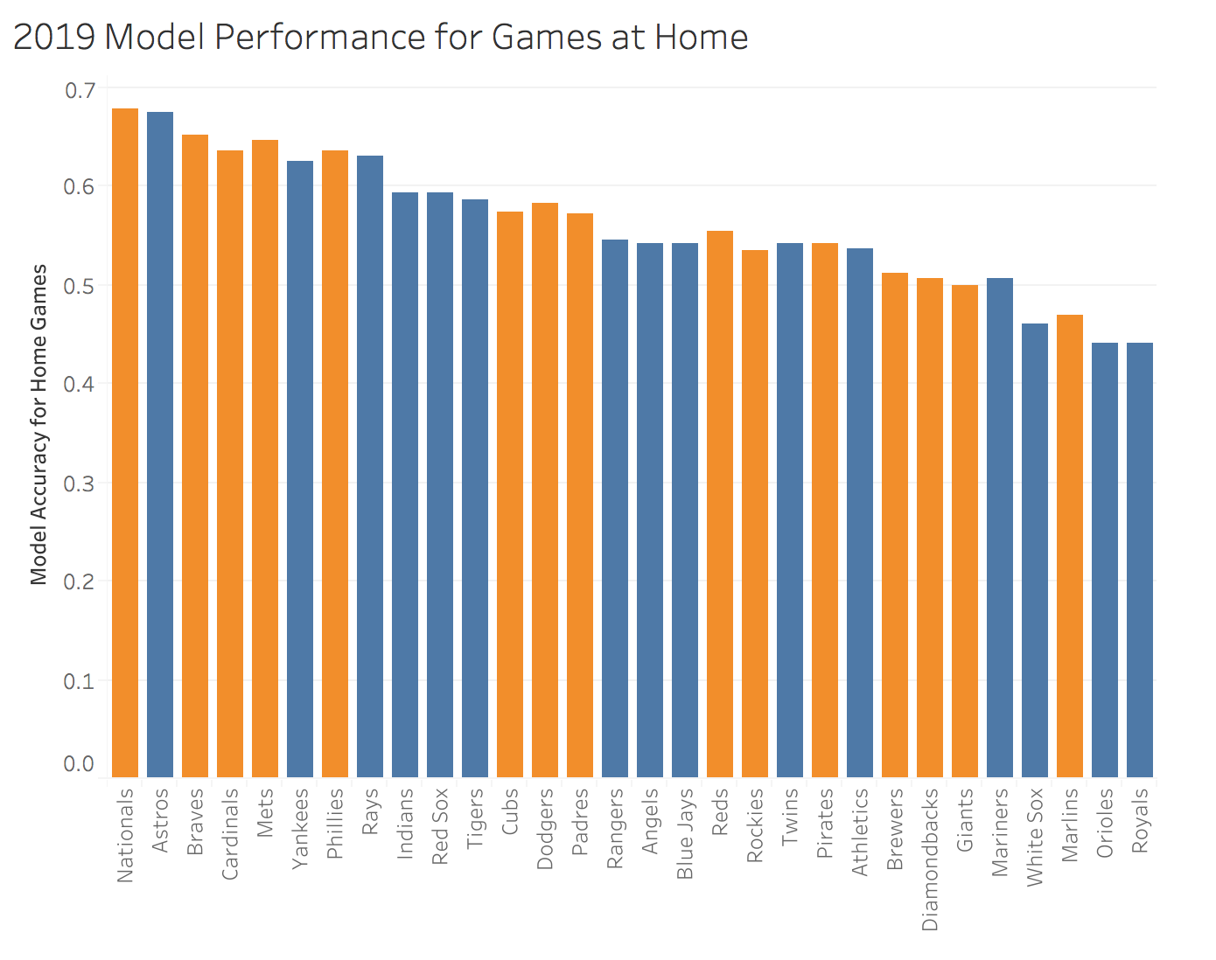
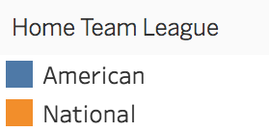
Model Results: MLB 2019
Notes:
162 games played per team. 30 teams. 2430 games per season

Slide 15
Model Results: MLB 2019
$18,719
Earned if you bet $100 on every MLB game in 2019
Notes:
162 games played per team. 30 teams. 2430 games per season

Slide 16
Model Results: Next Steps
Top Features
Home Team: Tigers
Week Day: Tuesday
Home Team: Red Sox
Away Team: Diamondbacks
Away Team: Astros
Away Team: Indians
Away Team: Orioles
Away Team: Dodgers
Home Team: Orioles
Home Team: Braves
More location and team-based features should be incorporated
Notes:
162 games played per team. 30 teams. 2430 games per season

Slide 17

Let’s Go Mets!
Notes:
162 games played per team. 30 teams. 2430 games per season

Slide 18
Appendix: Next Steps
Incorporate more locational/game-specific data:
Stadium data
Weather
Pitcher vs. Player data
Lefty vs. Righty, Righty vs. Righty, Righty vs. Lefty
Have the model work in real-time (predicting next game of the season), in a working web app
Notes:
162 games played per team. 30 teams. 2430 games per season

